Slide 1
Deep Learning Statistical Arbitrage Jorge Guijarro-Ordonez Markus Pelger Greg Zanotti
Discussion
Amit Goyal
25 August 2022
ABFR Webinar

Slide 2
Agenda
Quick summary.
Small picture comments (Clarifications / Nitpicking).
Big picture comments.
What are the authors really doing?
Why is their machine not so great?
What may be some other benchmarks?

Slide 3
Paper in a nutshell (1)
1. Summary
Formalized model for signal extraction and portfolio allocation for strategies that use past returns.
Important that the two steps are carried out jointly.

Slide 4
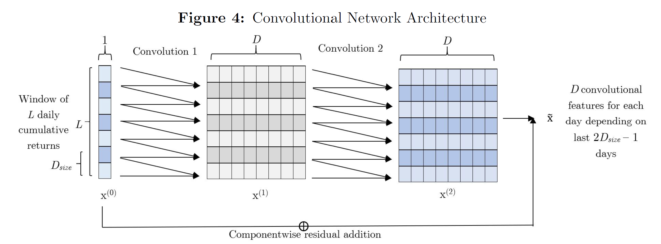
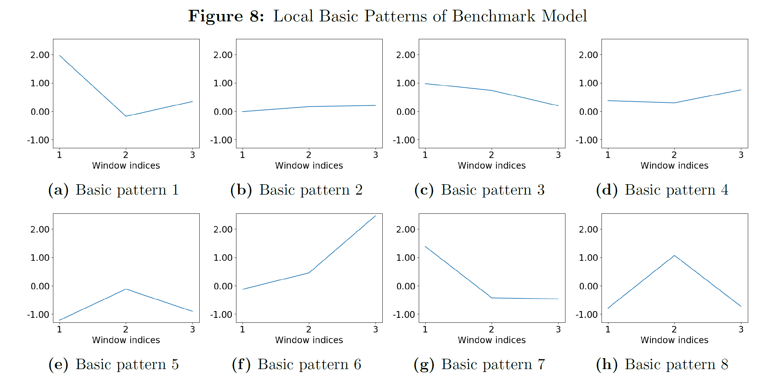
Paper in a nutshell (2)
1. Summary
Signal extraction step – CNN part.

Slide 5
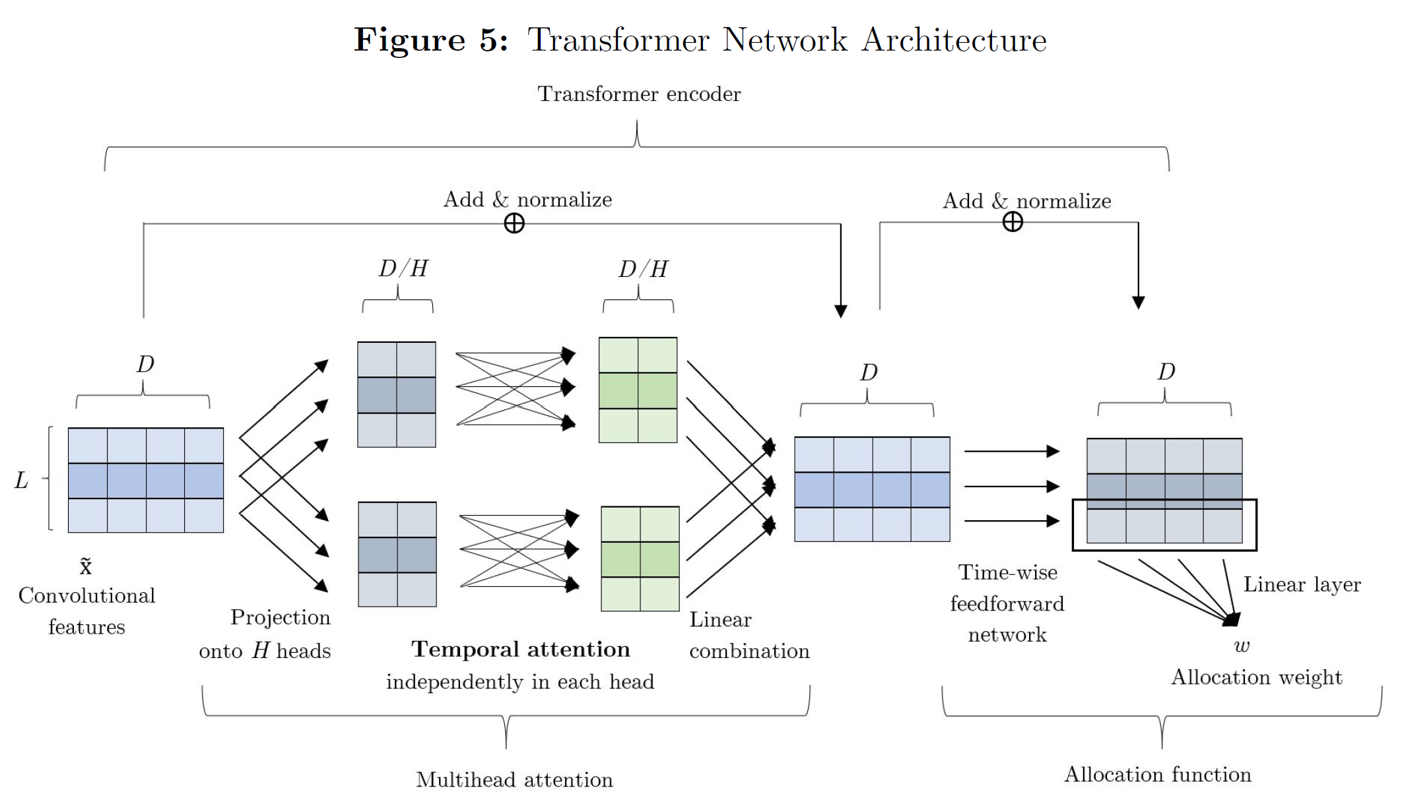
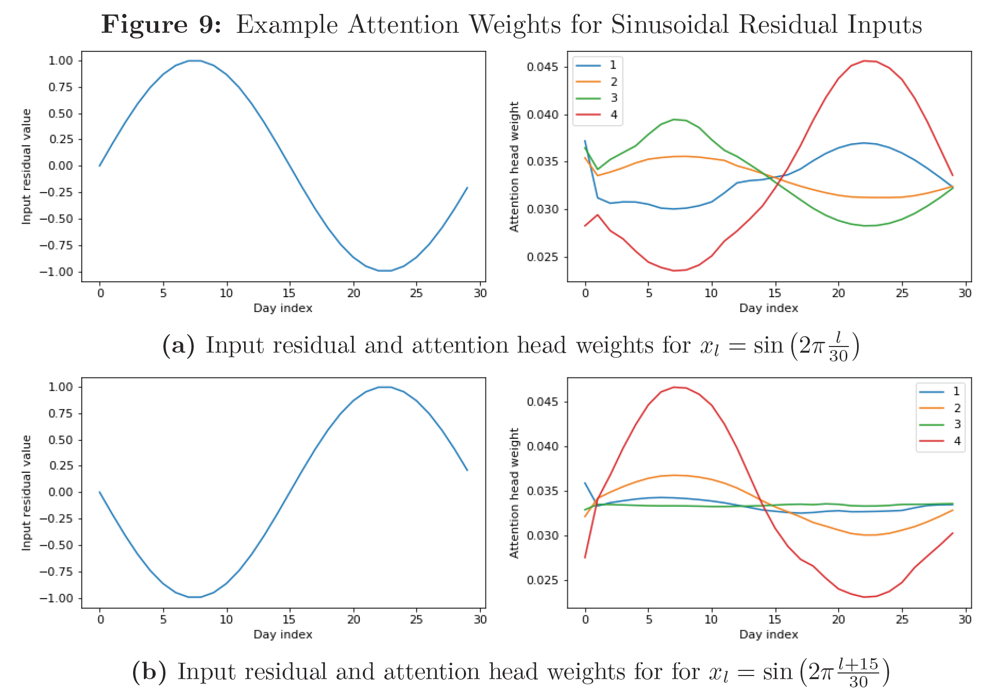
Paper in a nutshell (3)
1. Summary
Signal extraction step – Transformer part.

Slide 6
Paper in a nutshell (3)
1. Summary
In some math notation:
$$ε_{n,t−L:t−1}\left(Residual\right)→θ_{n,t−1}\left(Signal\right)→w_{n,t−1}(Weight).$$
$$\max{\frac{E\left[w_{t−1}^{′}R_{t}\right]}{SD\left[w_{t−1}^{′}R_{t}\right]}}.$$

Slide 7
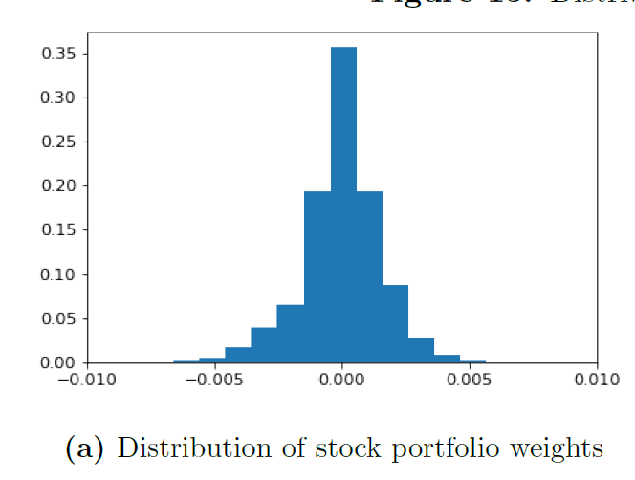
Clarifications (1)
2. Small picture comments
(a) When you maximize SR (or mv-utility) at time $t−1$, how do you form expectations of returns and volatility at time $t$?
(b) Do you have zero-cost or net long portfolios?
Page 23
Page 44

Slide 8
Clarifications (2)
2. Small picture comments
(c) Are residuals calculated from factor model with intercept or without
(d) Why is an OU process (basically an AR(1) process) good for modeling cumulative residuals (which, like prices, should have a trend)?
(e) What is need to define $x$ using cumulative residuals rather than just residuals? Seems more restrictive for the machine.

Slide 9
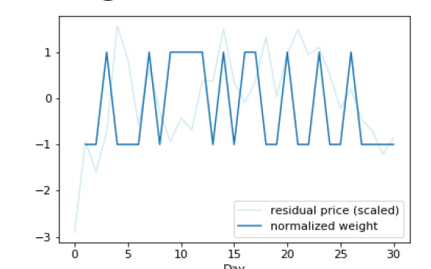
Clarifications (3)
2. Small picture comments
(f) Please change color coding.

Slide 10
Nitpicking (1)
2. Small picture comments
Mean return is 13.7% for zero factor model versus only 3.4% for 8-factor model. 8-factor alpha is 11.6% for zero factor model versus only 3.3% for 8-factor model. I know that the goal is to maximize SR but still …

Slide 11
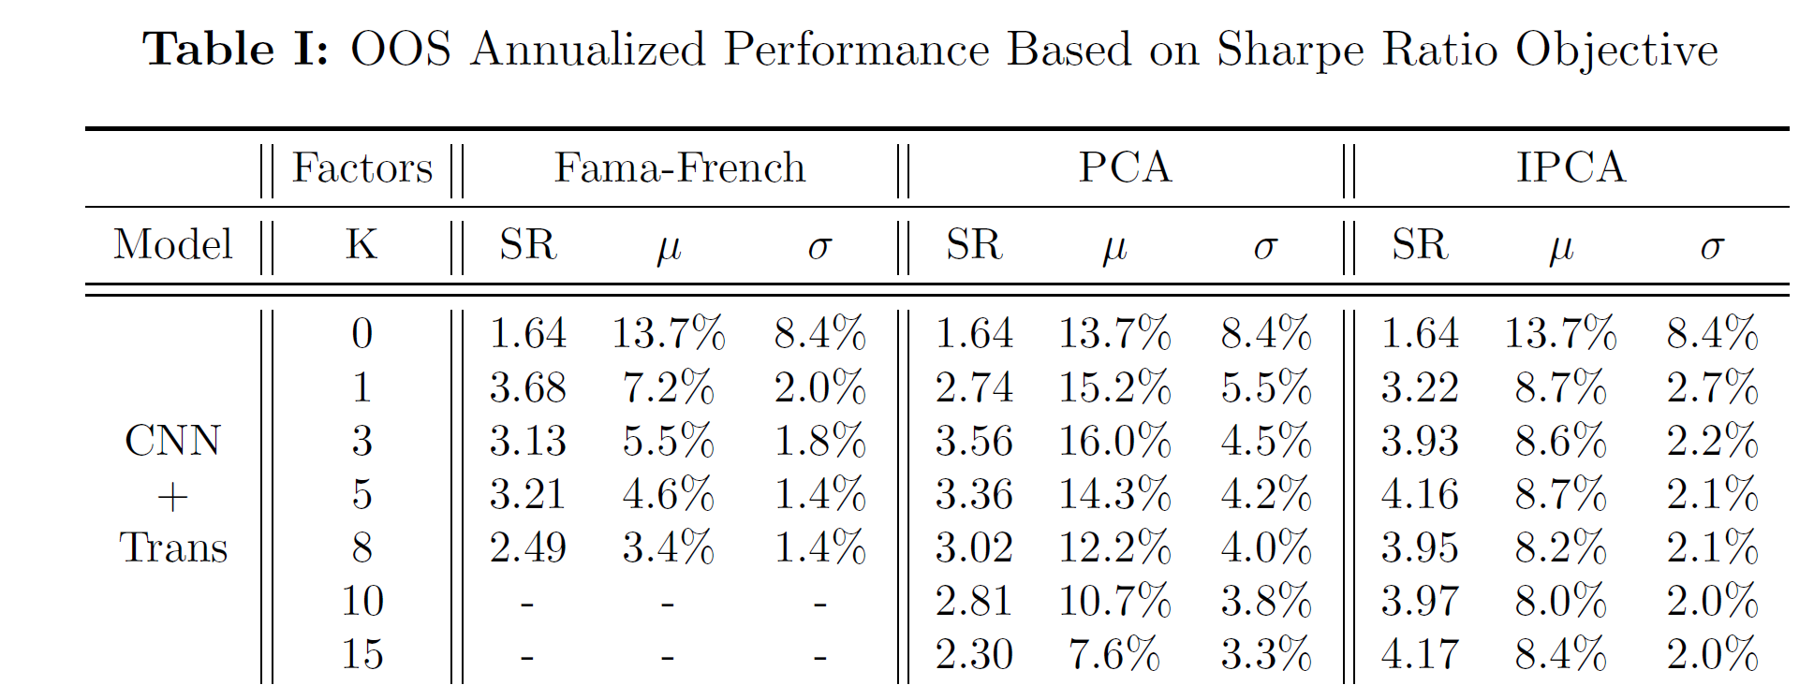
Nitpicking (2)
2. Small picture comments
Annualized volatility of portfolios from $K≥5$ factor models is 1%-4%. This is magical!

Slide 12
Nitpicking (3)
2. Small picture comments
For $K=0$, $R^{2}\sim 30\%$ but $α∼μ$. ⇒ Risk adjustment matters for betas but not alphas. ⇒ Factor premia are small, or they cancel each other.

Slide 13
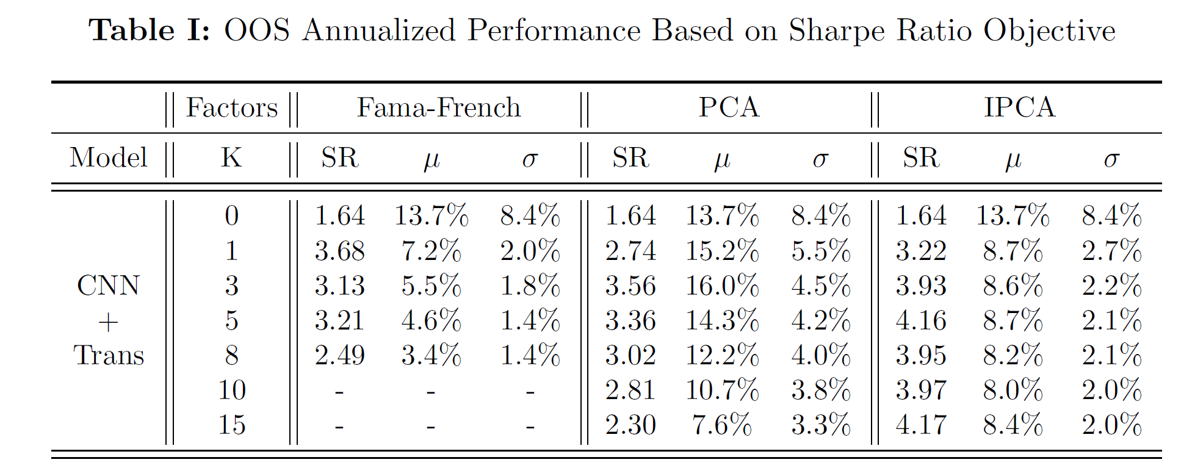
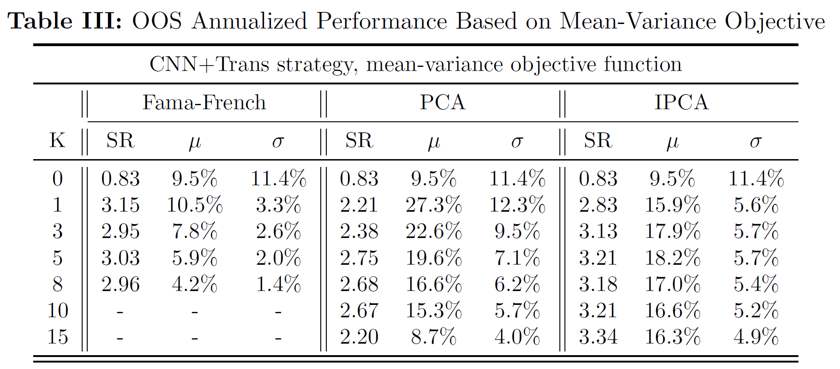
Nitpicking (4)
2. Small picture comments
For FF factors, SR is higher when the objective is mean-variance than when it is Sharpe ratio.

Slide 14
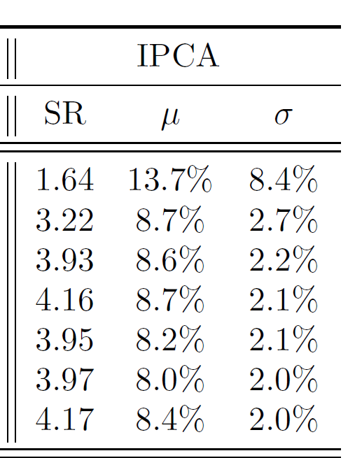
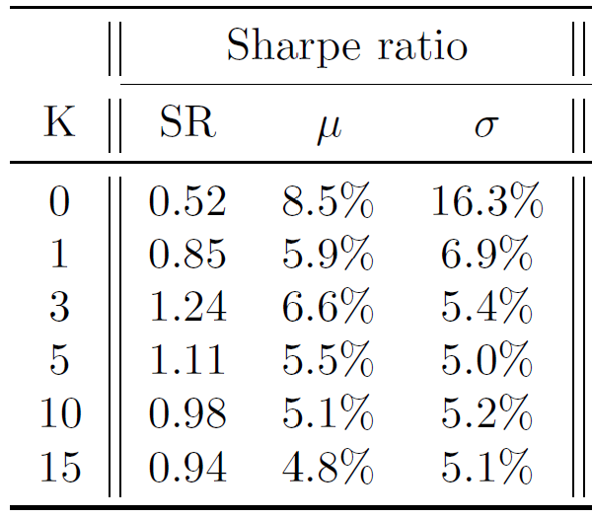
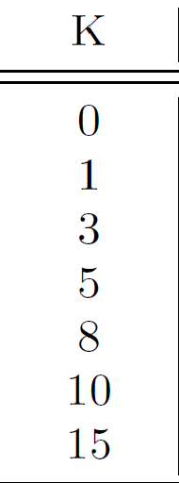
Nitpicking (5)
2. Small picture comments
With trading costs, mean declines (as is to be expected) but volatility increases (why?).
Decline in returns is ~5% annualized or 2bps per day. Since you pay 5bps per transaction, you are doing 0.4 transactions per day. That sounds too low.
Without t-costs
With t-costs

Slide 15
Terminology (1)
3a. What the paper is really about
An arbitrage portfolio (for example, pairs trading) is not just a long-short portfolio.
For example, a Value−Growth portfolio is not an arbitrage portfolio.
If you want, you can just go long value stocks because you believe that they are undervalued.
If you want, you can just go short growth stocks because you believe that they are overvalued.
An arbitrage portfolio is a relative value trade where you buy asset B and sell asset S not because you believe that B is undervalued and S in overvalued but because you believe that B is undervalued relative to S (or S is overvalued relative to B).

Slide 16
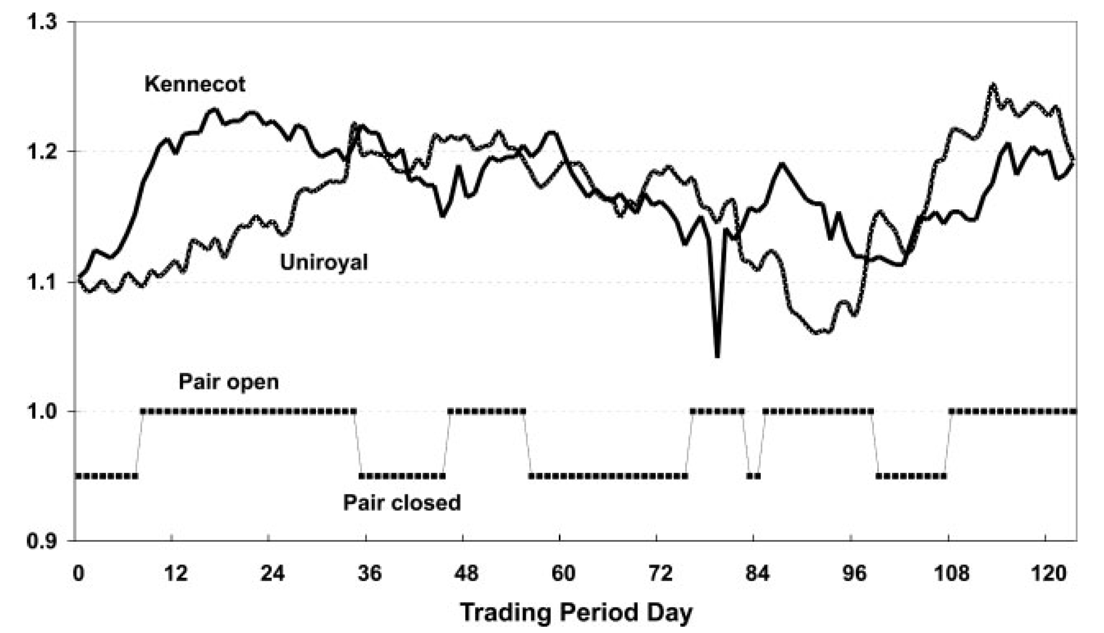
Terminology (2)
3a. What the paper is really about
This means that the signals for an arbitrage trade have to come from both the long and the short side.
Whether to buy (or sell) Kennecot is based not only on Kennecot’s own price performance but also on Uniroyal’s price performance.
Source: Gatev, Goetzmann, and Rouwenhorst (2006)

Slide 17
Terminology (3)
3a. What the paper is really about
If a buy/sell signal is based on only one’s own prior price performance, $θ_{n,t}=θ_{n,t}(ε_{n,t}^{L}$), then that trade is closer to a technical trading rule than an arbitrage trade rule.
Therefore, this paper’s framework is more about technical trading than about statistical arbitrage.
The title of the paper should be:
“Deep Learning Technical Trading”

Slide 18
My data
3b. Machine not that smart
CRSP share code = 10 or 11.
Top 500 market capitalization stocks (chosen 60 days before portfolio formation date).
Daily rebalanced equal-weighted decile portfolios.
Residuals calculated from 8-factor model (MktmRf, SMB, HML, RMW, CMA, STR, MOM, and LTR) calculated on a 60-day rolling window.
Sample period is 1998 to 2021 (24 years).

Slide 19
My ‘machine’
3b. Machine not that smart
Signal comes from cumulative past returns, $θ_{n,t−1}=R_{n,t−L:t−1}$, or residuals, $θ_{n,t−1}=ε_{n,t−L:t−1}$ for a past window of $L$ days.
Allocation function is simple average for the extreme returns:
$$w_{n,t−1}=\left\{\begin{aligned}−2\% if θ_{n,t−1}<10th percentile \\ +2\% if θ_{n,t−1}>90th percentile.\end{aligned}\right.$$

Slide 20
Loser−Winner return for sorts on return (1)
3b. Machine not that smart
 |  | Return | Alpha5 | Alpha8 |  | Return | Alpha5 | Alpha8
 |  | No Skip Day |  |  |  | Yes Skip Day
 |  | Sort on Return(−1)
R/α |  | 12.38 | 12.14 | 7.50 |  | 24.52 | 25.38 | 19.89
 |  | (2.47) | (2.50) | (1.58) |  | (4.93) | (5.22) | (4.25)
SR/IR |  | 0.50 | 0.51 | 0.32 |  | 1.01 | 1.07 | 0.87
 |  | Sort on Return(−5:−1)
R/α |  | 27.81 | 28.70 | 17.35 |  | 30.71 | 31.26 | 19.51
 |  | (4.91) | (5.35) | (3.77) |  | (5.62) | (5.95) | (4.43)
SR/IR |  | 1.00 | 1.09 | 0.77 |  | 1.15 | 1.21 | 0.90
 |  | Sort on Return(−22:−1)
R/α |  | 21.16 | 22.30 | 4.54 |  | 16.09 | 17.37 | 0.60
 |  | (3.58) | (4.15) | (1.61) |  | (2.77) | (3.24) | (0.19)
SR/IR |  | 0.73 | 0.85 | 0.33 |  | 0.56 | 0.66 | 0.04
Why not (2022)
Lehmann (1990)
Jegadeesh (1990)

Slide 21
Loser−Winner return for sorts on return (2)
3b. Machine not that smart
Looking back a month does not help.
Skipping a day helps for sorts on recent returns.
Risk adjustment matters (alphas < returns).
Volatility of portfolios is around 25% annualized.
Can get Sharpe ratios of around 1.1.

Slide 22
Loser−Winner return for sorts on residual (1)
3b. Machine not that smart
 |  | Return | Alpha5 | Alpha8 |  | Return | Alpha5 | Alpha8
 |  | No Skip Day |  |  |  | Yes Skip Day
 |  | Sort on Resid8(−1)
R/α |  | 18.20 | 17.87 | 15.97 |  | 14.98 | 15.09 | 13.33
 |  | (6.06) | (6.00) | (5.41) |  | (5.27) | (5.34) | (4.77)
SR/IR |  | 1.24 | 1.22 | 1.10 |  | 1.08 | 1.09 | 0.97
 |  | Sort on Resid8(−5:−1)
R/α |  | 19.43 | 19.34 | 16.09 |  | 15.29 | 15.33 | 12.31
 |  | (6.40) | (6.51) | (5.60) |  | (5.24) | (5.33) | (4.42)
SR/IR |  | 1.31 | 1.33 | 1.14 |  | 1.07 | 1.09 | 0.90
 |  | Sort on Resid8(−22:−1)
R/α |  | 13.03 | 13.12 | 8.85 |  | 8.89 | 9.16 | 5.24
 |  | (4.32) | (4.55) | (3.30) |  | (2.98) | (3.20) | (1.95)
SR/IR |  | 0.88 | 0.93 | 0.67 |  | 0.61 | 0.65 | 0.40
Blitz, Huij, Lansdorp, and Verbeek (2013) and Chaves (2016)

Slide 23
Loser−Winner return for sorts on residuals (2)
3b. Machine not that smart
Looking back a month does not help.
Skipping a day hurts a bit.
Risk adjustment does not matter (alphas ~ returns).
Volatility of portfolios is around 15% annualized.
Can get Sharpe ratios of around 1.1.

Slide 24
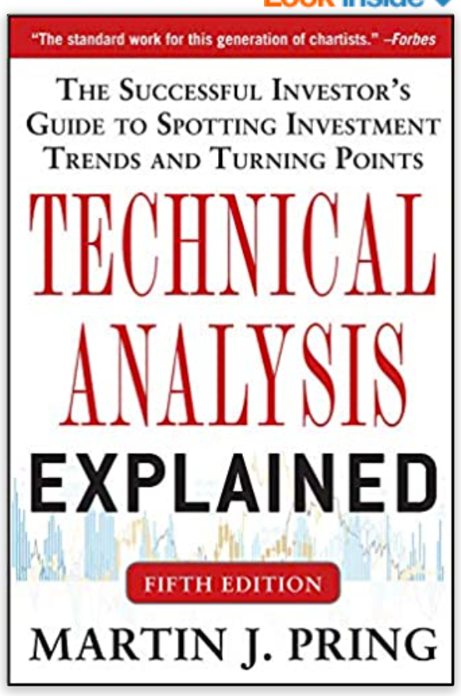
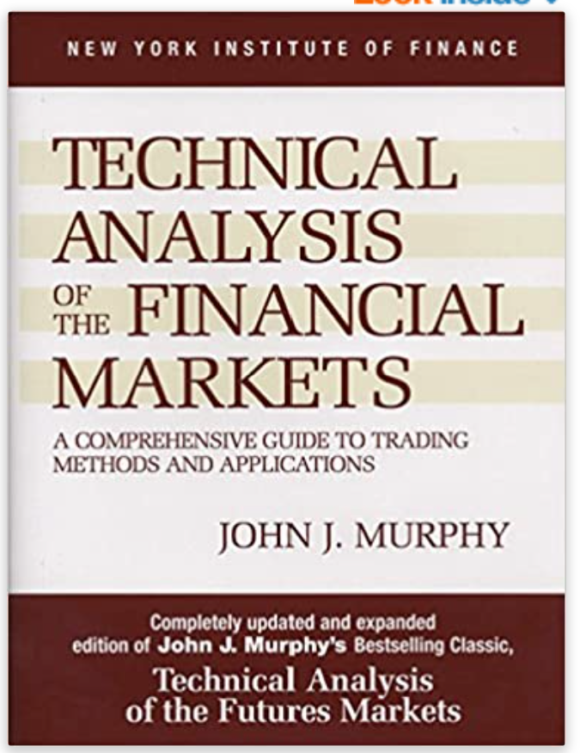
What are some other benchmarks?
3c. Some other benchmarks
Since you are basically doing technical trading, why not benchmark yourself against technical trading rules?

Slide 25
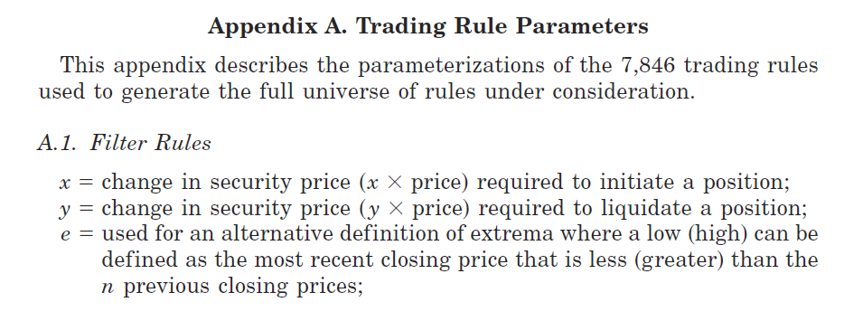
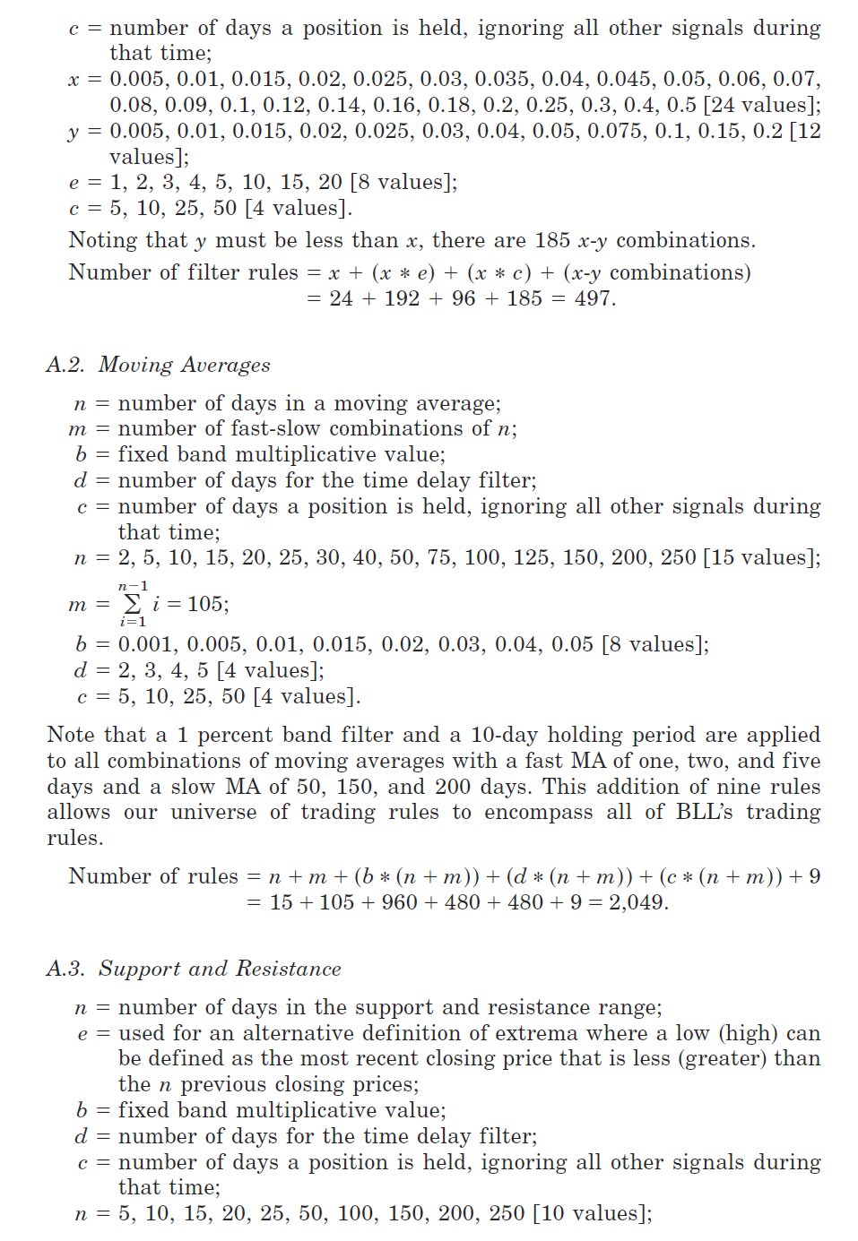
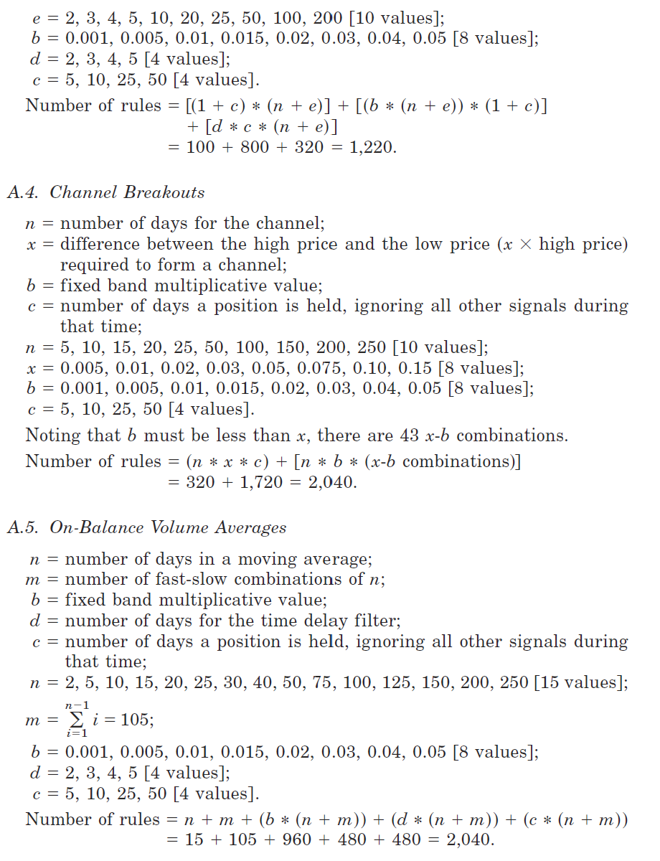
Technical trading rules (Sullivan, Timmermann, and White, 1999)
3c. Some other benchmarks

Slide 26
References
Blitz, David, Joop Huij, Simon Lansdorp, and Marno Verbeek, 2013, “Short-Term Residual Reversal,” Journal of Financial Markets 16(3), 477‒504.
Chaves, Denis B., 2016, “Idiosyncratic Momentum: U.S. and International Evidence,” Journal of Investing 25(2), 64‒76.
Gatev, Evan, William N. Goetzmann, and K. Geert Rouwenhorst, 2006, “Pairs Trading: Performance of a Relative-Value Arbitrage Rule,” Review of Financial Studies 19(3), 797‒827.
Jegadeesh, Narasimhan, 1990, “Evidence of Predictable Behavior of Security Returns,” Journal of Finance 45(3), 881‒898.
Lehmann, Bruce N., 1990, “Fads, Martingales, and Market Efficiency,” Quarterly Journal of Economics 105(1), 1‒28.
Sullivan, Ryan, Allan Timmermann, and Halbert White, 1999, “Data-Snooping, Technical Trading Rule Performance, and the Bootstrap,” Journal of Finance 54(5), 1647‒1691.

